Slide 1
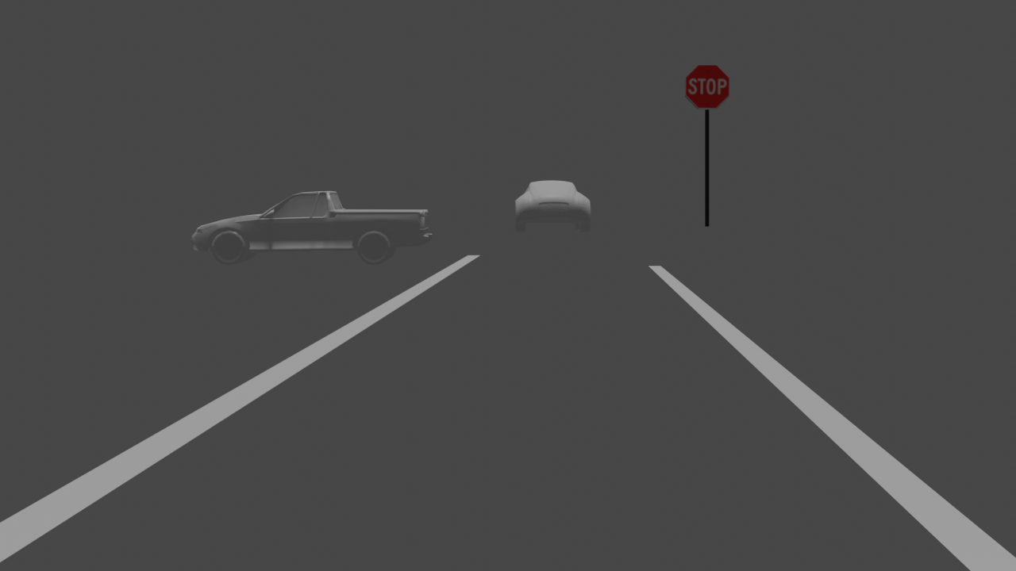
Project 3 Einstein Vision
Aabha Tamhankar
Miheer Diwan

Slide 2
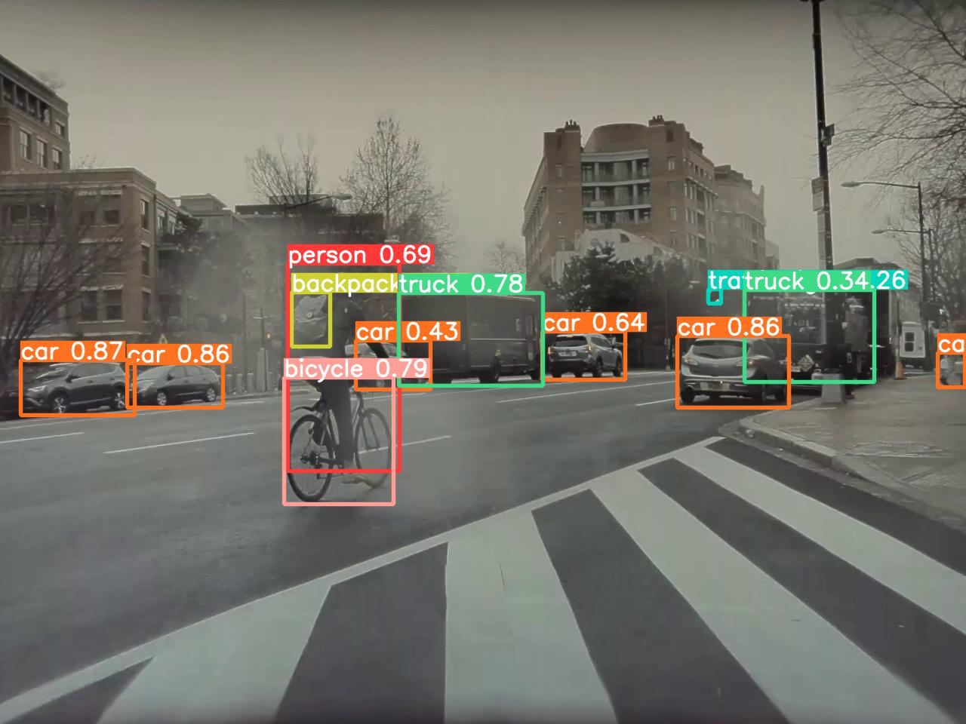
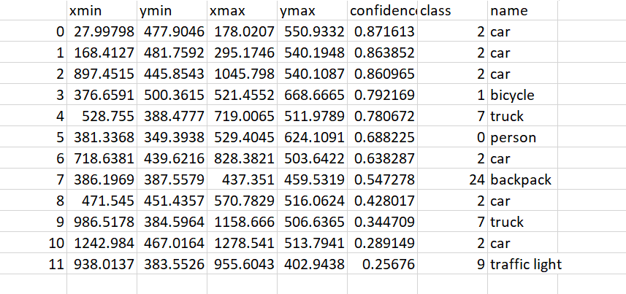

Object Detection and Classification
Model Used: YOLOv5
The model can detect multiple classes (80 total) including cars, trucks, bicycles, traffic signals, stop signs, and pedestrian and generates 2D bounding boxes around the objects.
The coordinates of the bounding boxes were obtained using this pre-trained model in and stored in a .csv file.
Blender assets were spawned at the mean of the 'x' coordinates of the image.
https://github.com/ultralytics/yolov5/issues/36

Slide 3
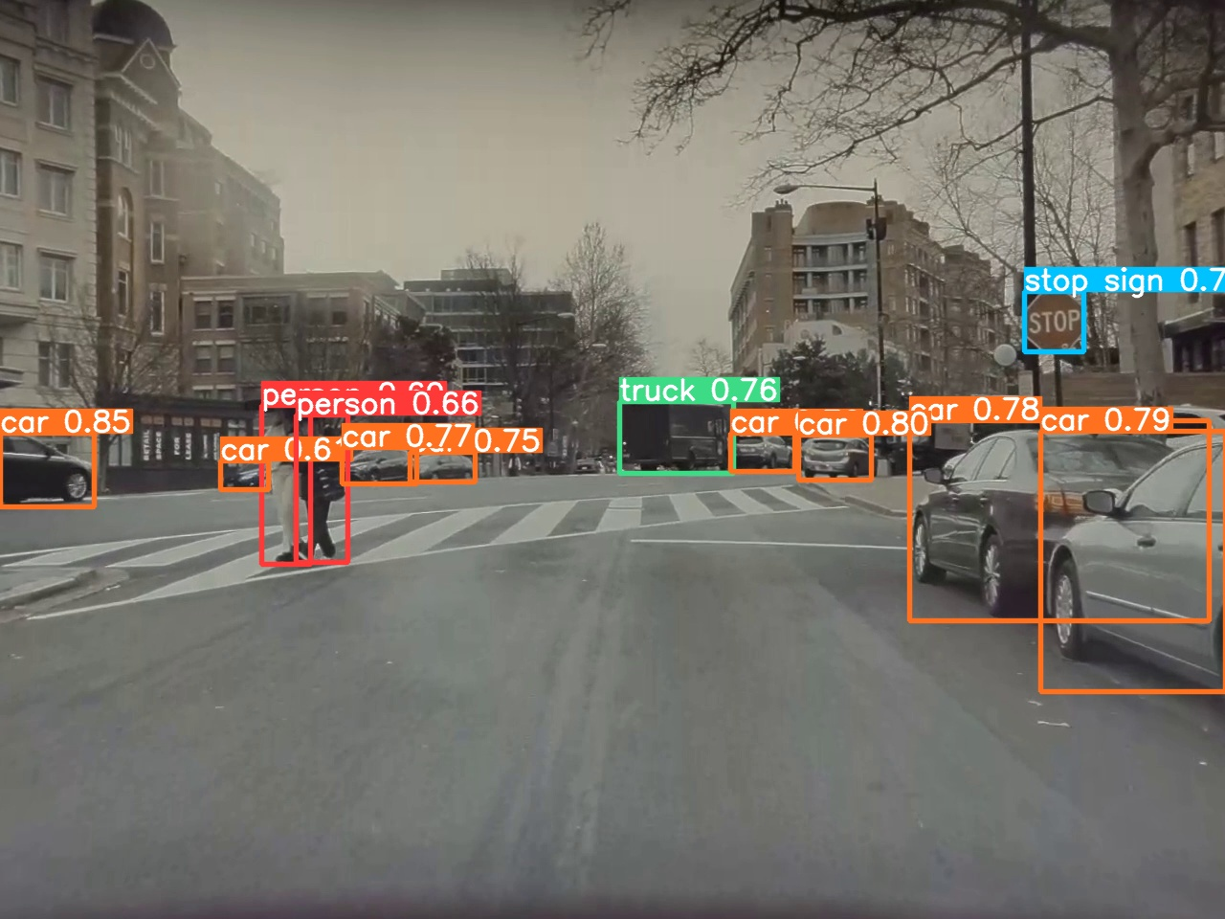
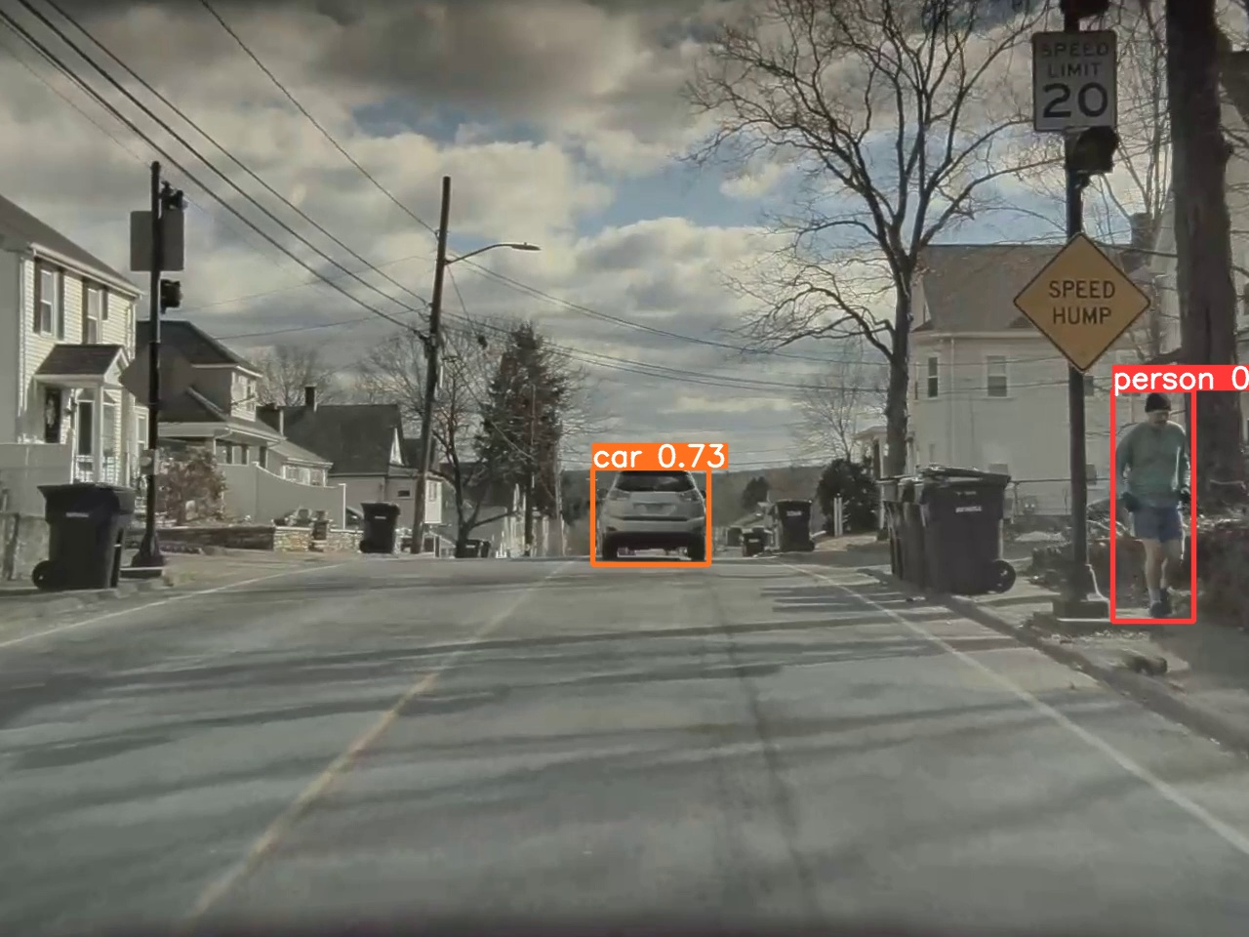
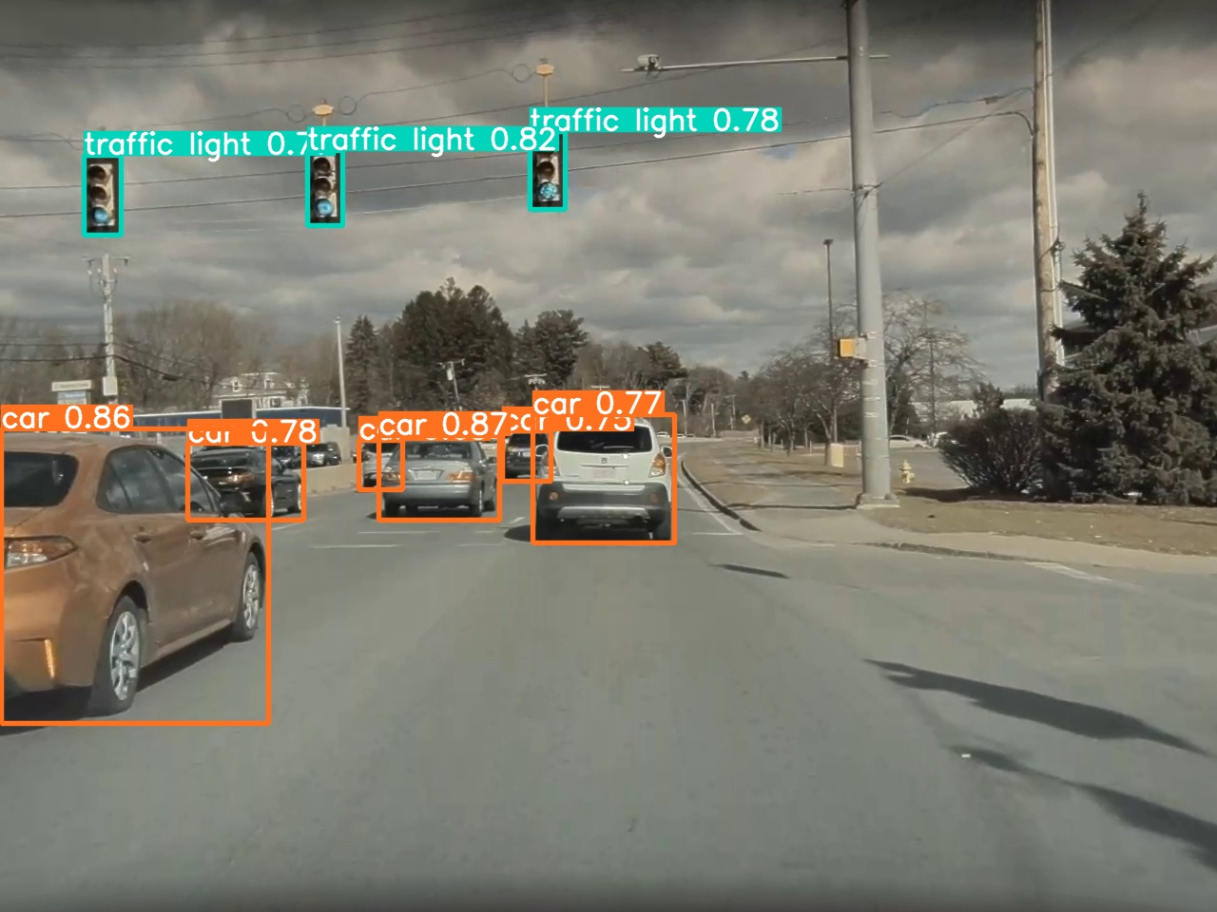
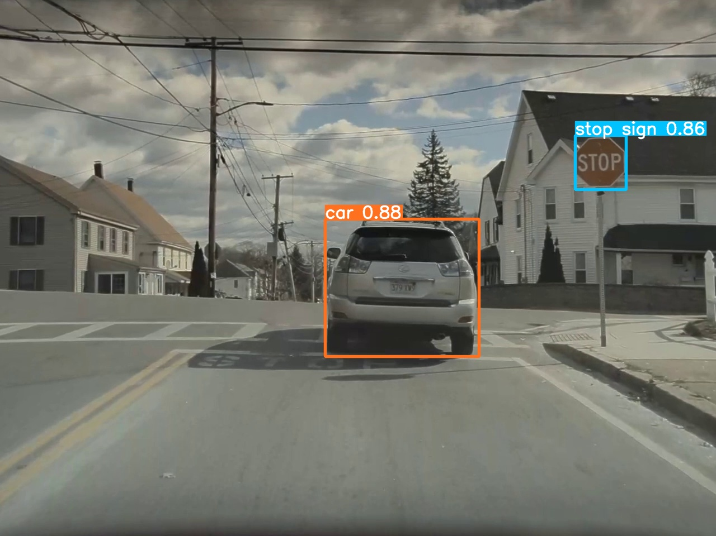

Slide 4
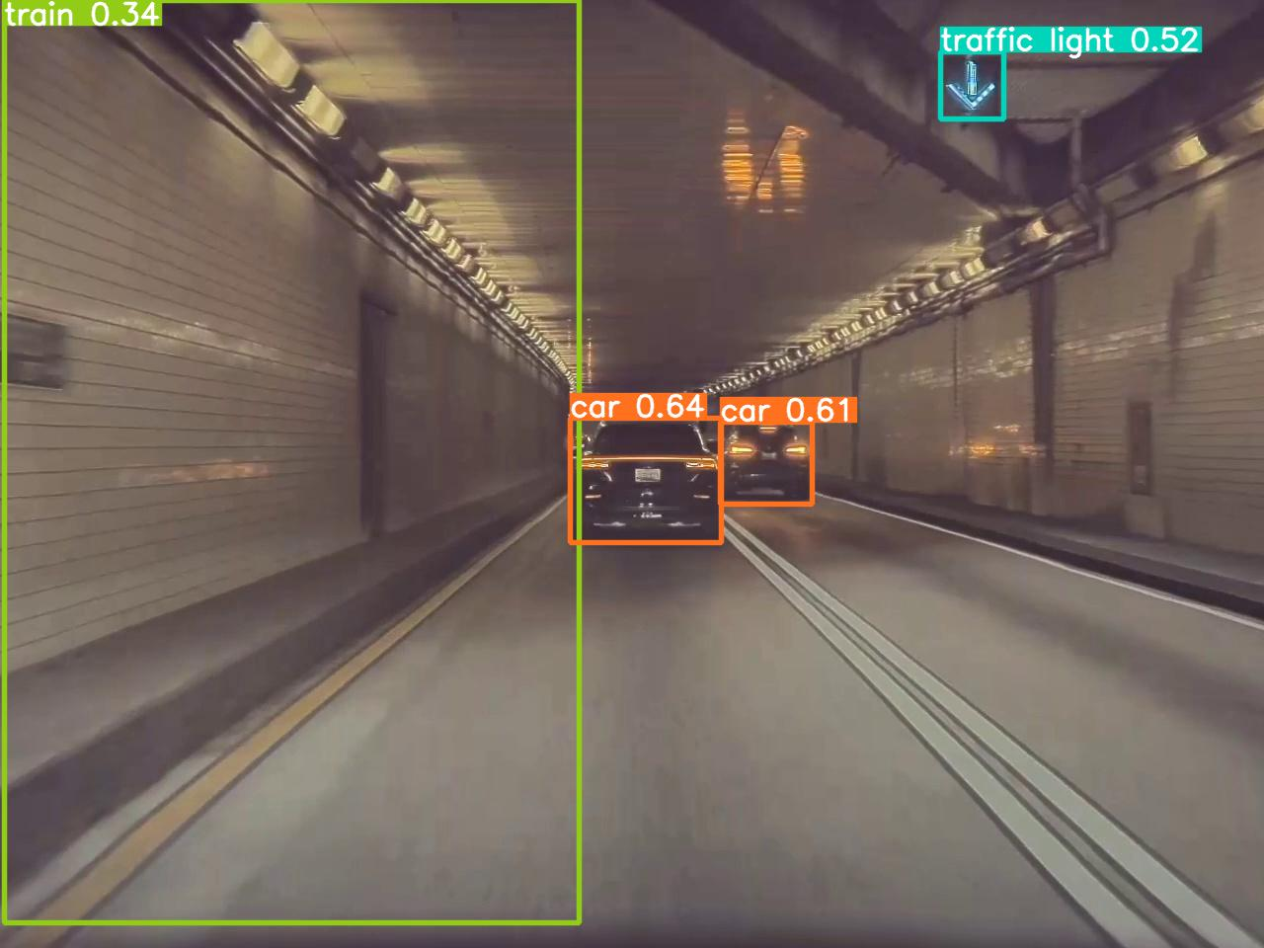
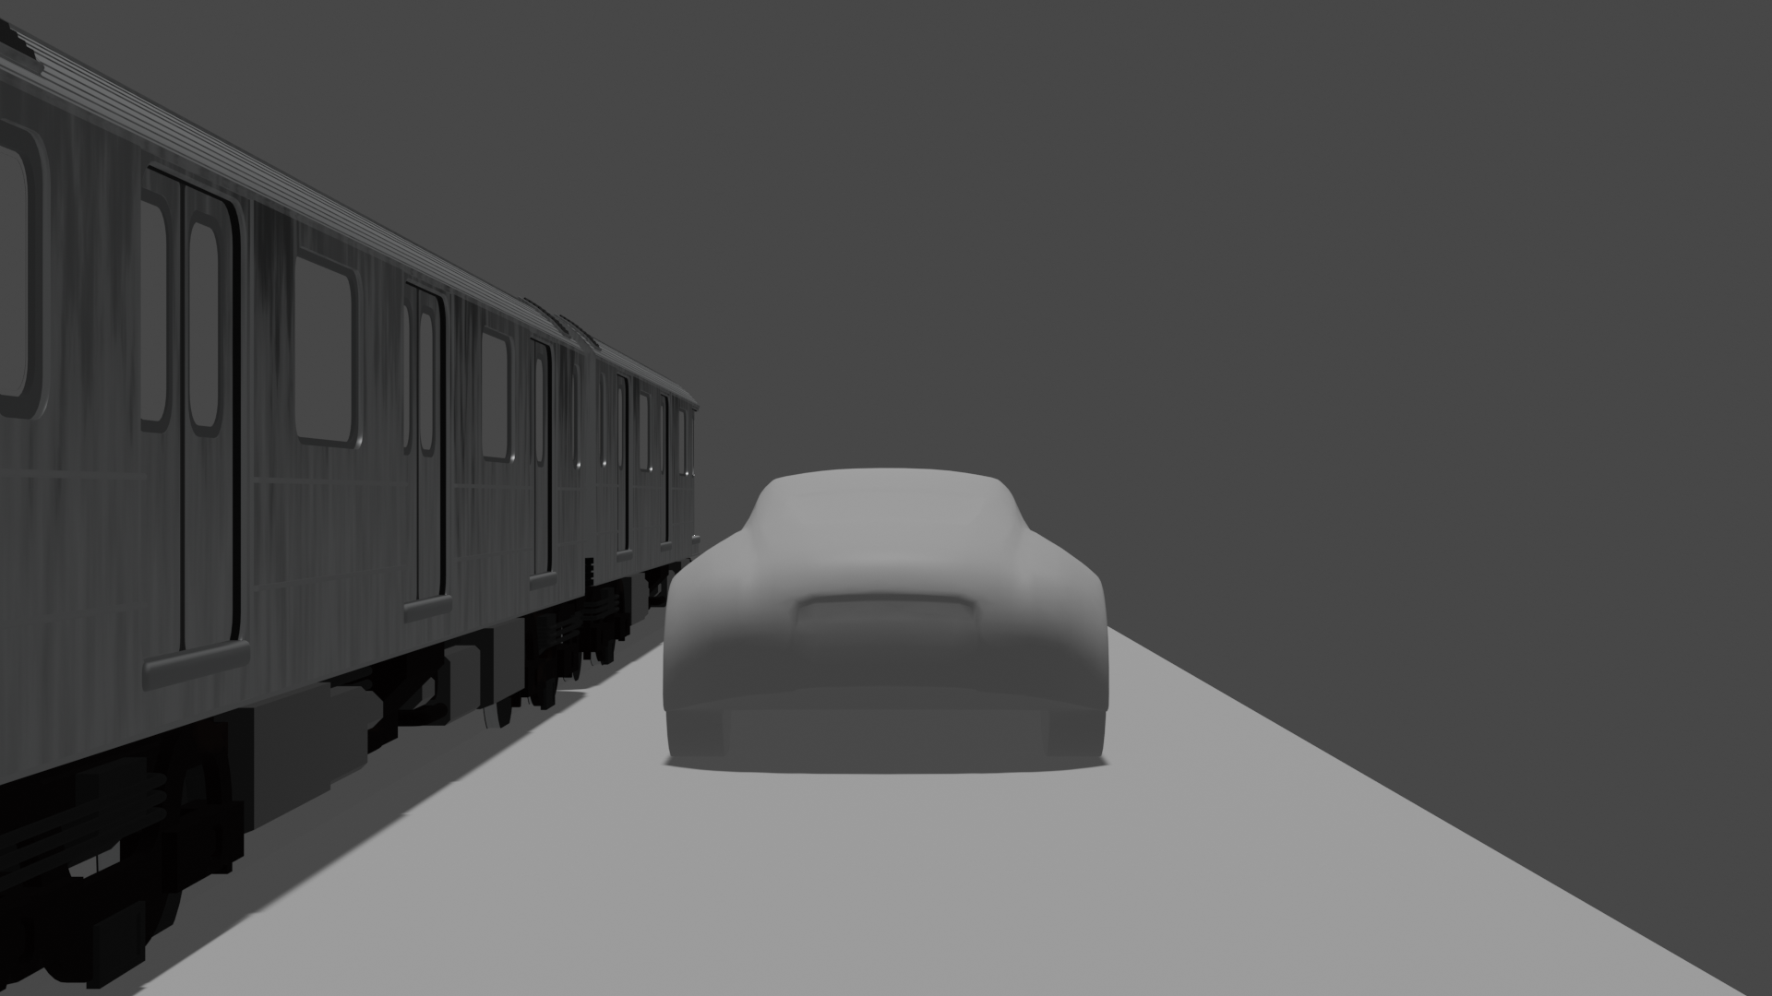
Outliers and Issues
Solution: Thresholding based on the confidence values.

Slide 5
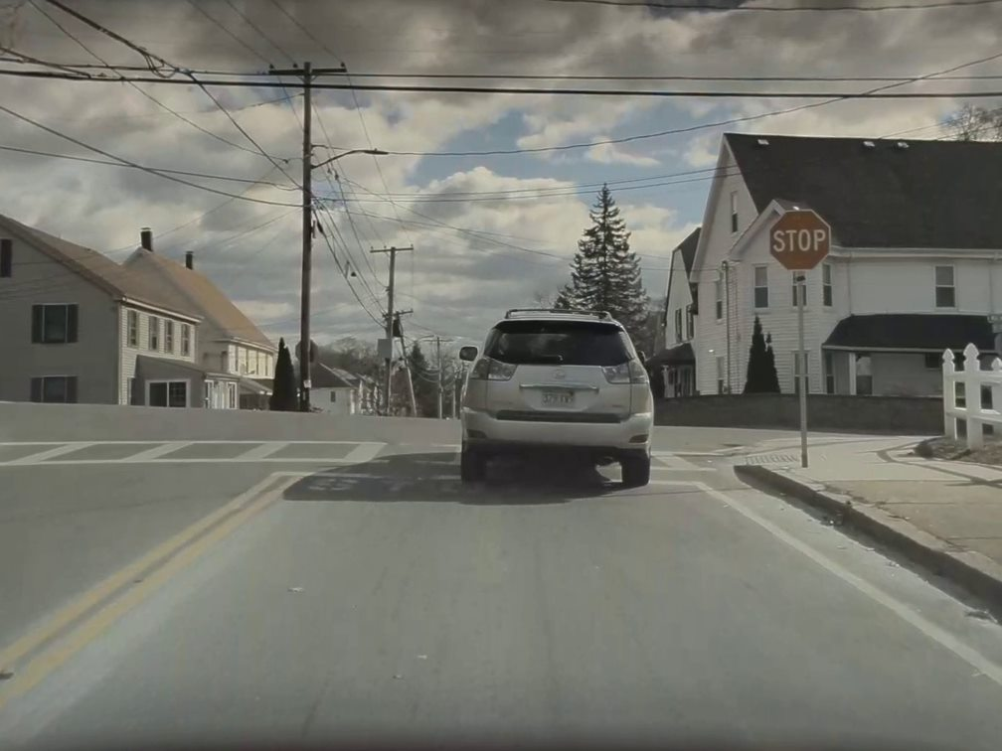
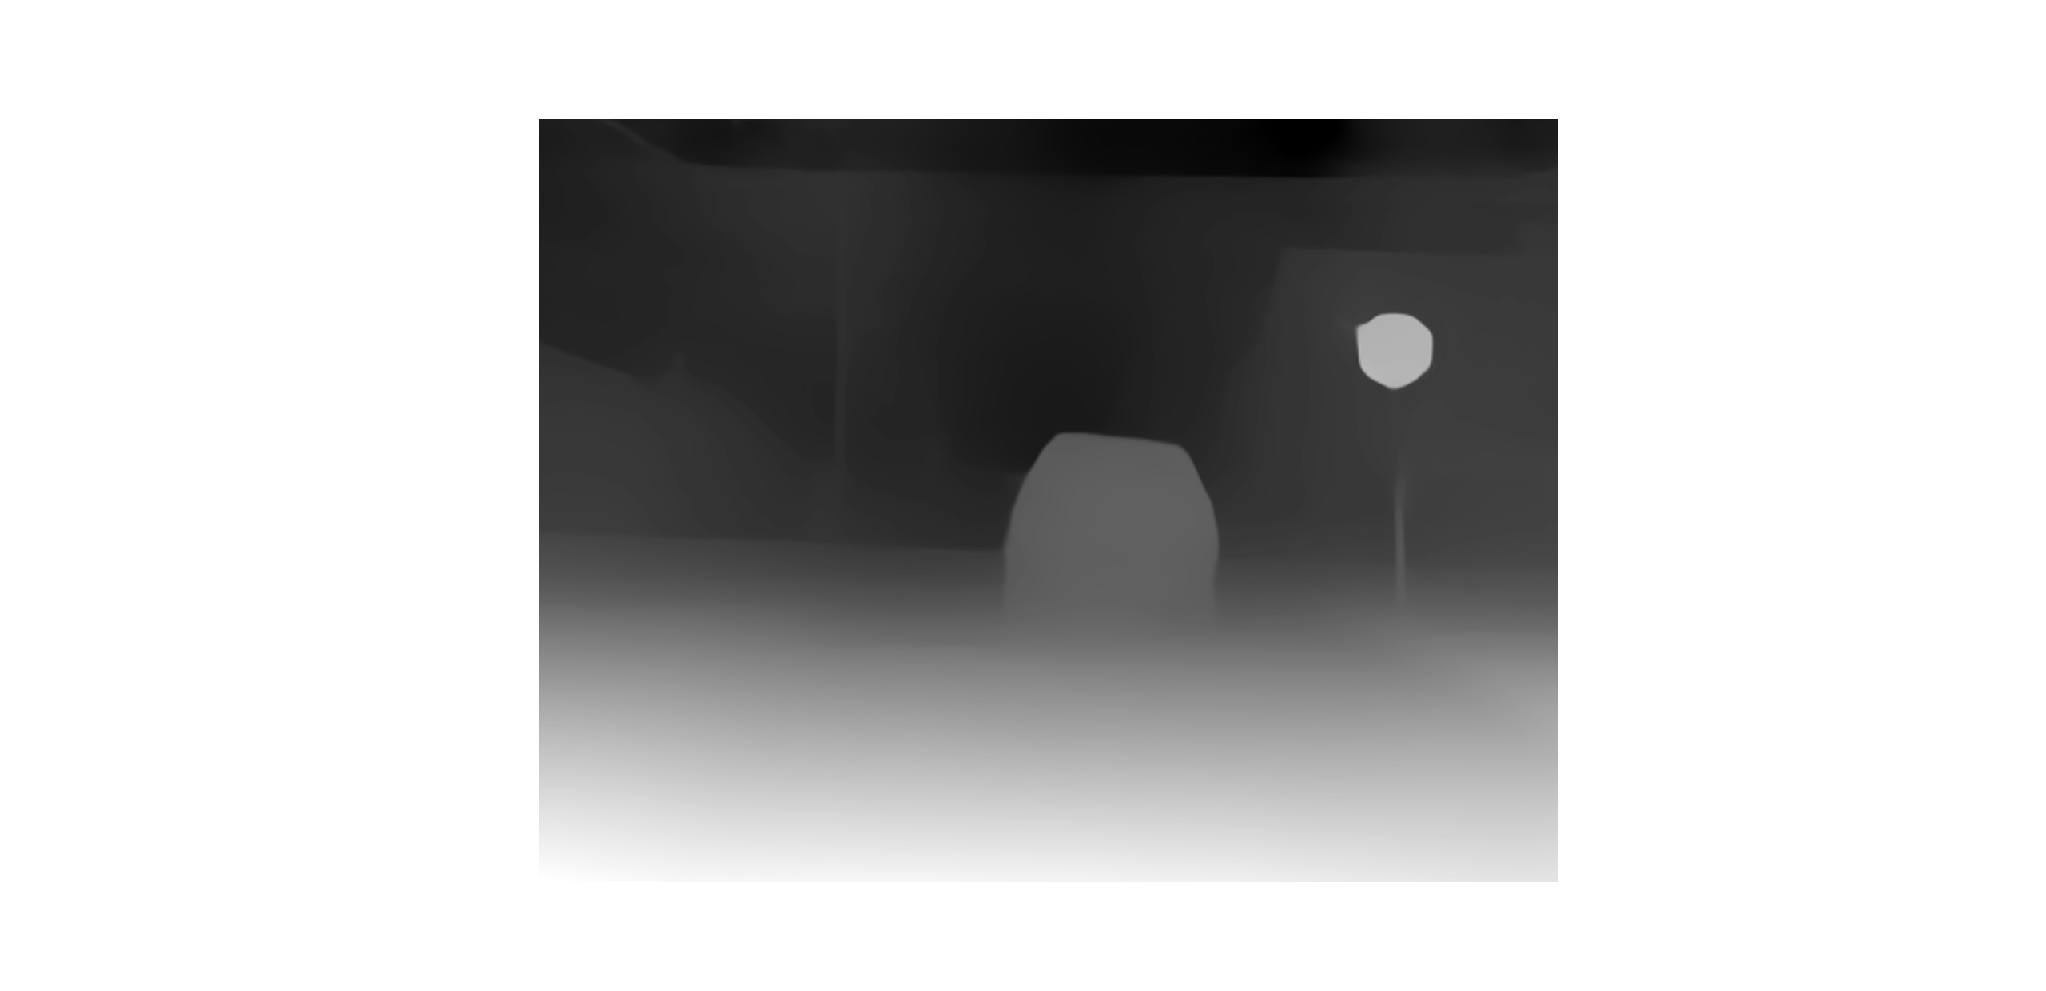
Depth Estimation
Model Used: Intel MiDaS (DPT Large)
Highest accuracy and slowest inference time
The model generates a depth map of the input image.
Using the coordinates from the classification network, we find the average depth value in the cropped region.
To find the relative depth we found the minimum and maximum depth for each image. Here, the minimum value corresponds to the farthest object in the image (and/or the background) while the maximum value implies the closest object in the image.
https://towardsdatascience.com/depth-estimation-1-basics-and-intuition-86f2c9538cd1

Slide 6
https://pytorch.org/hub/intelisl_midas_v2/

Slide 7
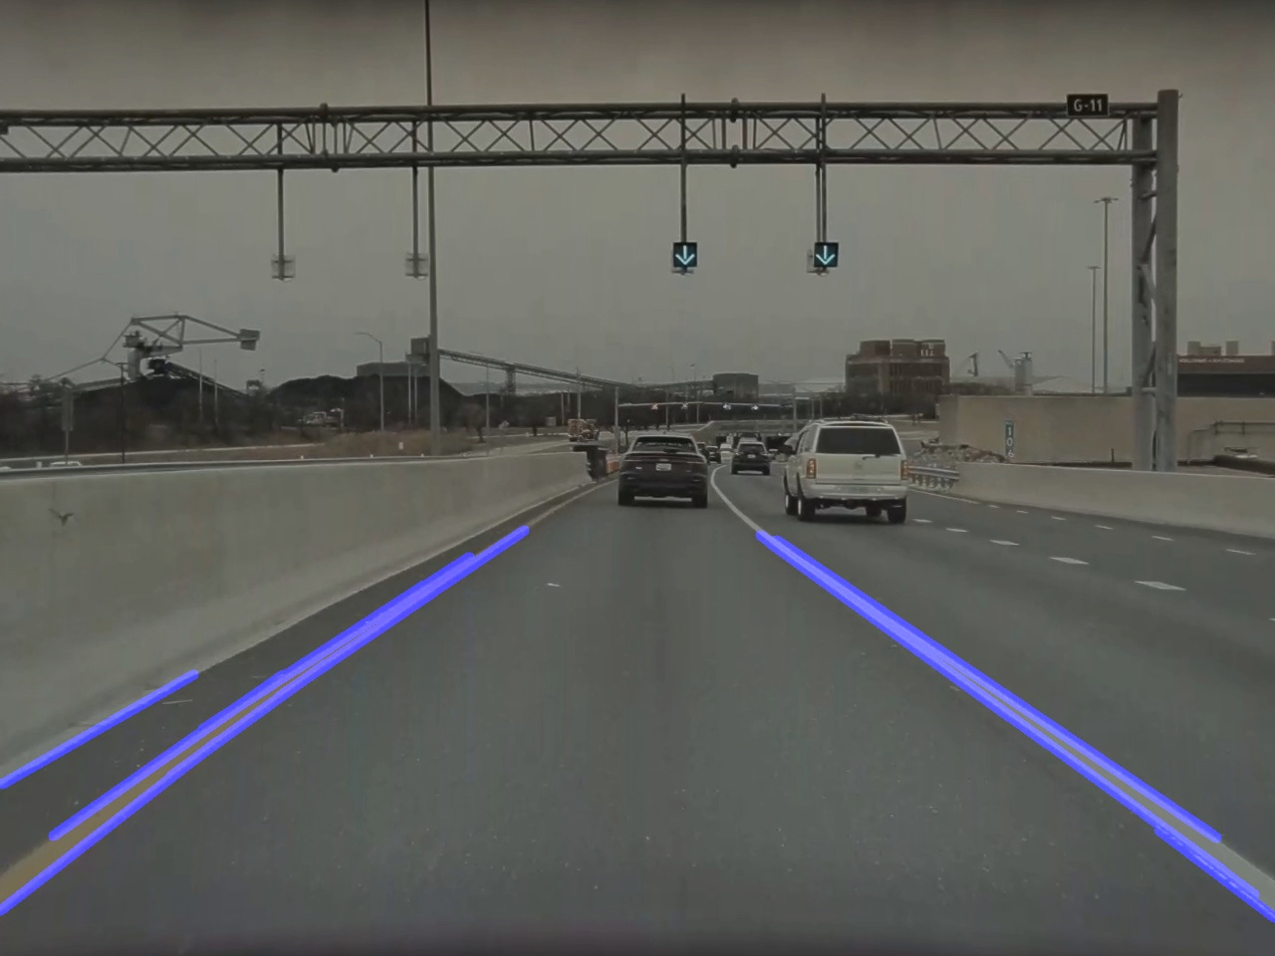
Lane Detection
We implemented Lane Detection using the classical method.
The 'cv2.HoughLinesP' function was used to detect the edges in the image and draw lines on these detected edges. This function returns the start and end point of the detected lines.
Using these coordinates, we can draw lines on the original image to show the detected lanes.
https://medium.com/computer-car/udacity-self-driving-car-nanodegree-project-1-finding-lane-lines-9cd6a846c58c

Slide 8
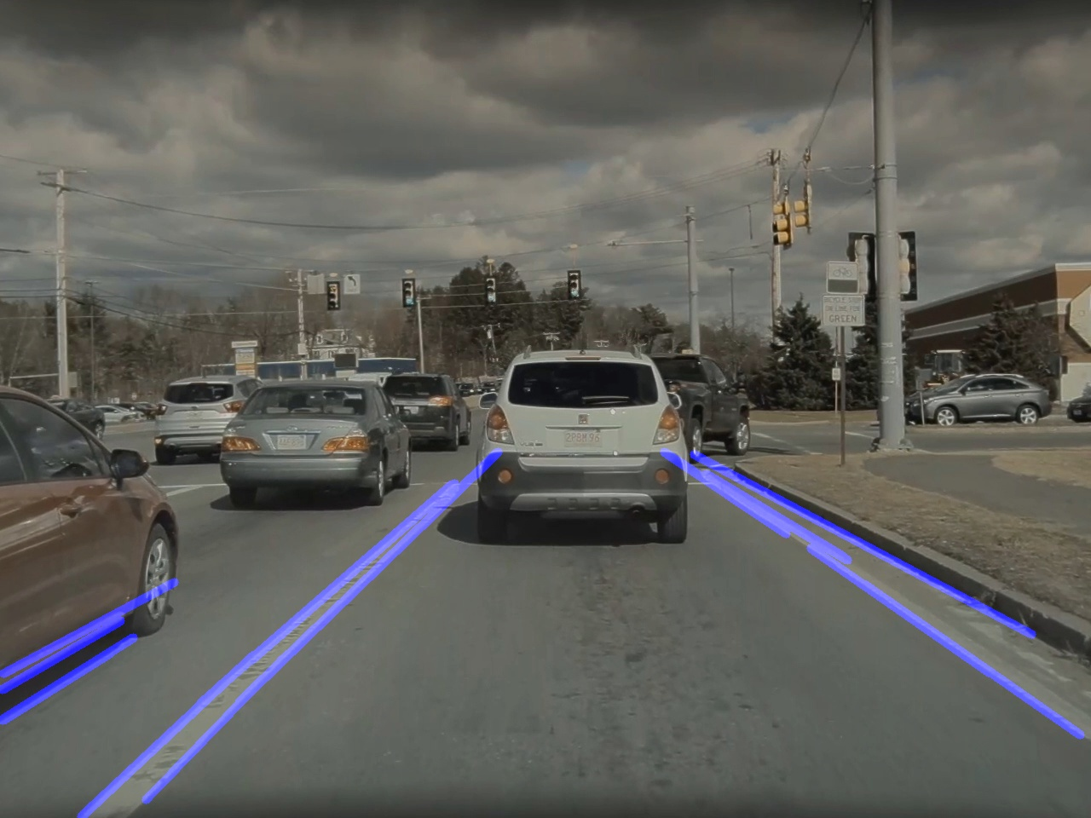
Issues:
This approach is not robust and requires parameter optimization for different scenes. Even after that it does not guarantee good results. However, it gave us better results than the deep learning approaches that we found.
Horizontal lines were also being detected. We fixed this by adding a constraint on the slope of the detected line. If the slope was < 0.5, the line was ignored.
Multiple lines are detected on a single lane and if you try to render all of these in Blender, it creates a mess. To avoid this, we only considered the minimum (left most) and maximum (rightmost) 'x' coordinates and spawned lanes at these locations in Blender.
https://medium.com/computer-car/udacity-self-driving-car-nanodegree-project-1-finding-lane-lines-9cd6a846c58c

Slide 9
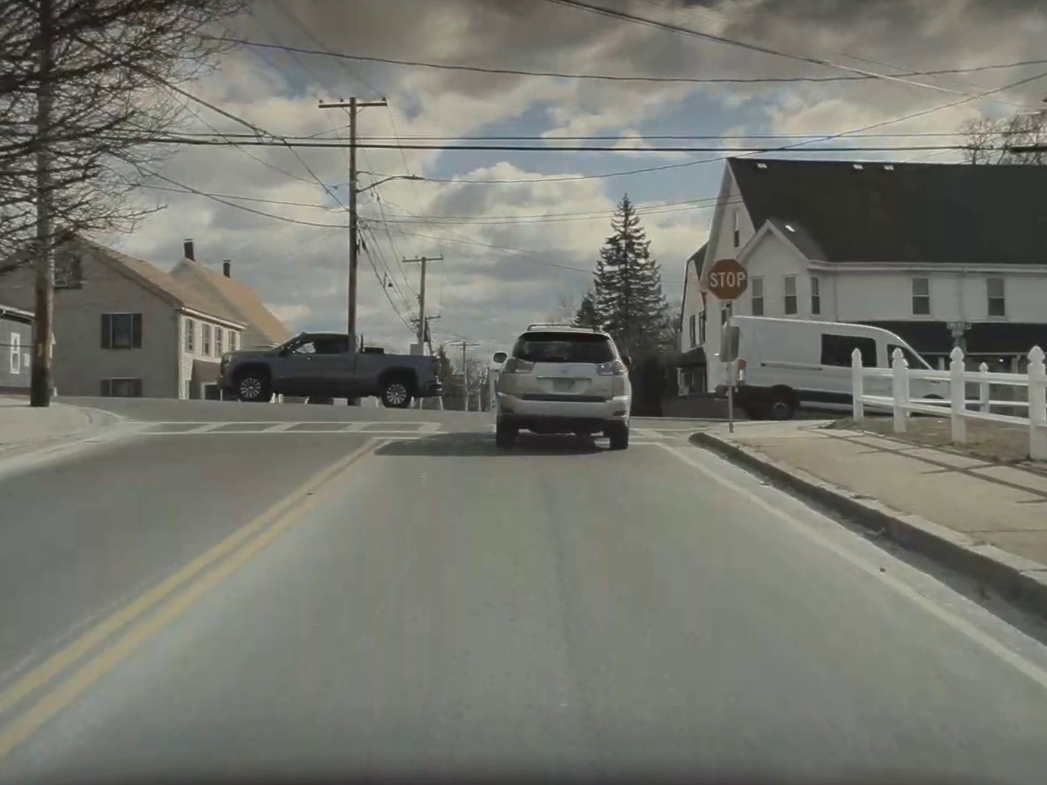
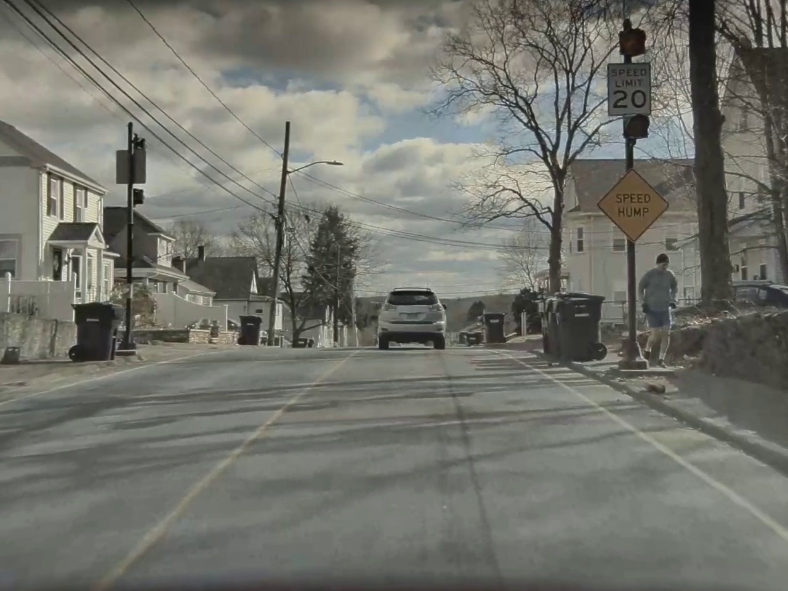
Vehicle and Human Pose Estimation

Slide 10
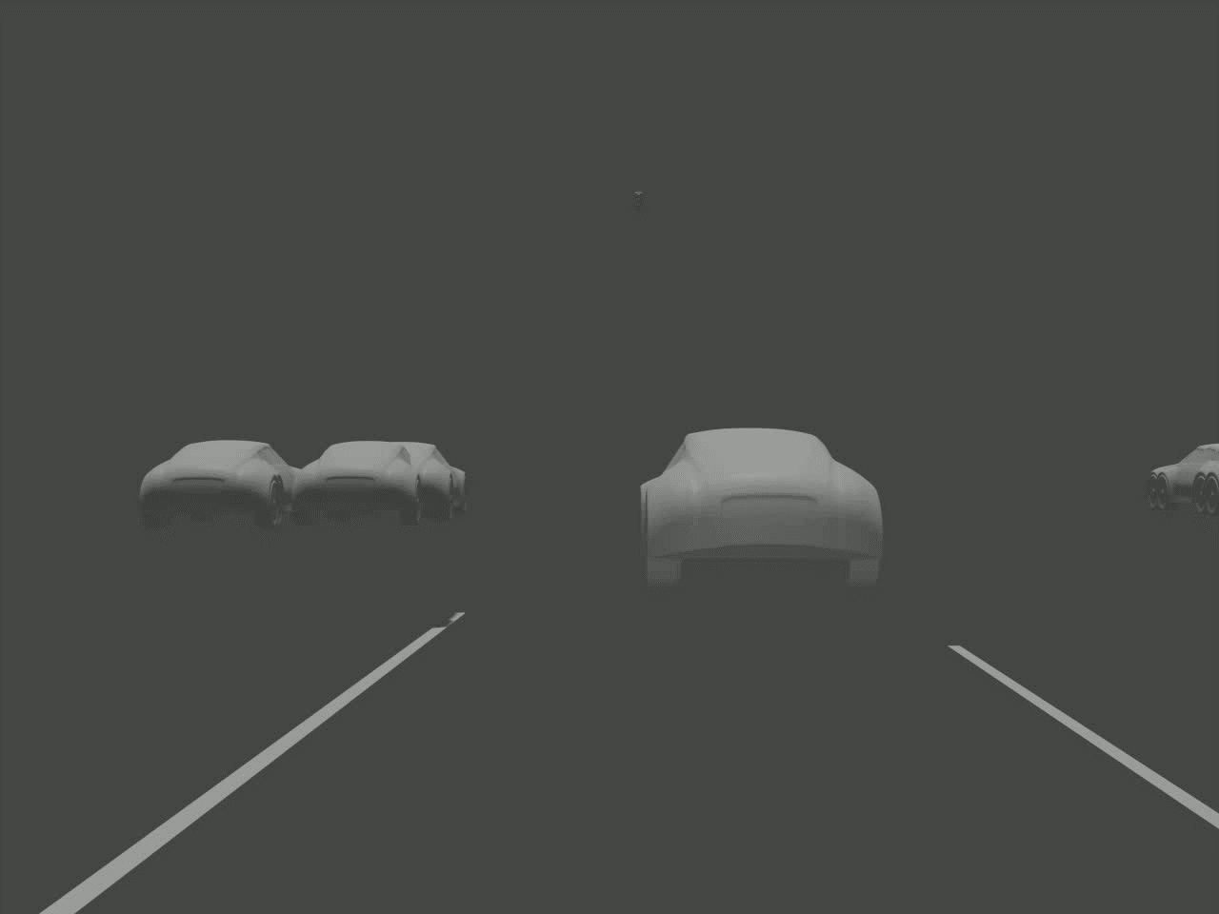
Final Video: Scene 4

Slide 11
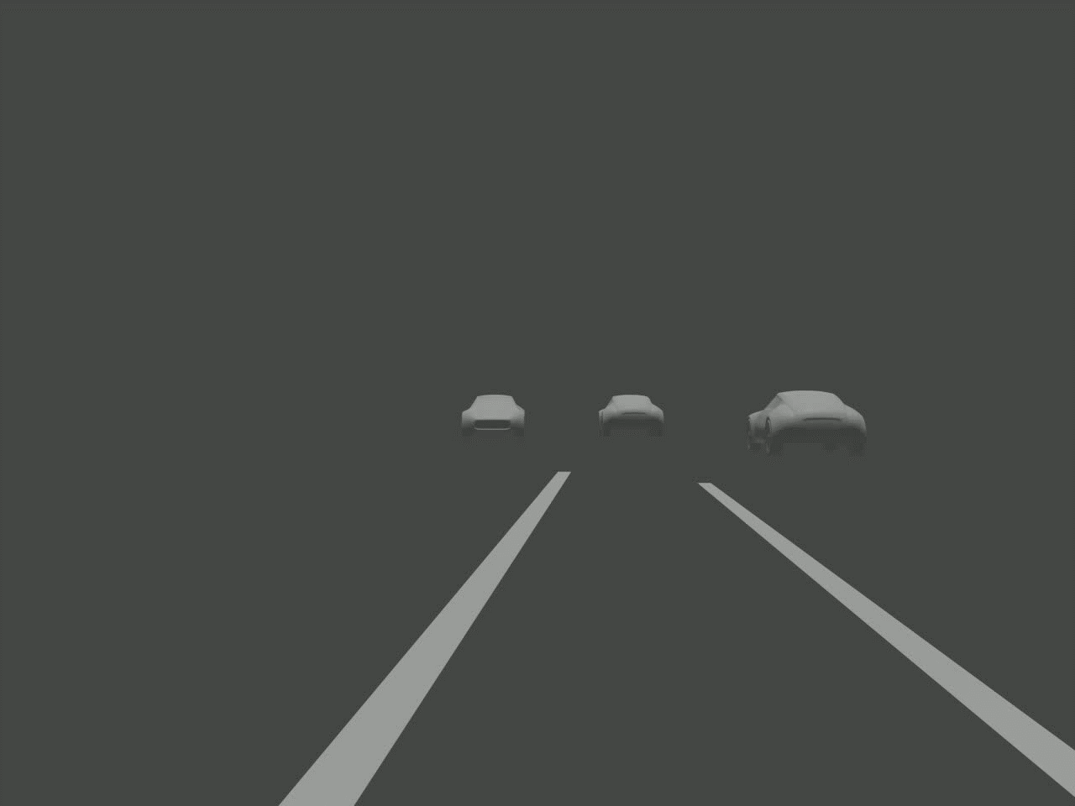
Final Video: Scene 5

Slide 12
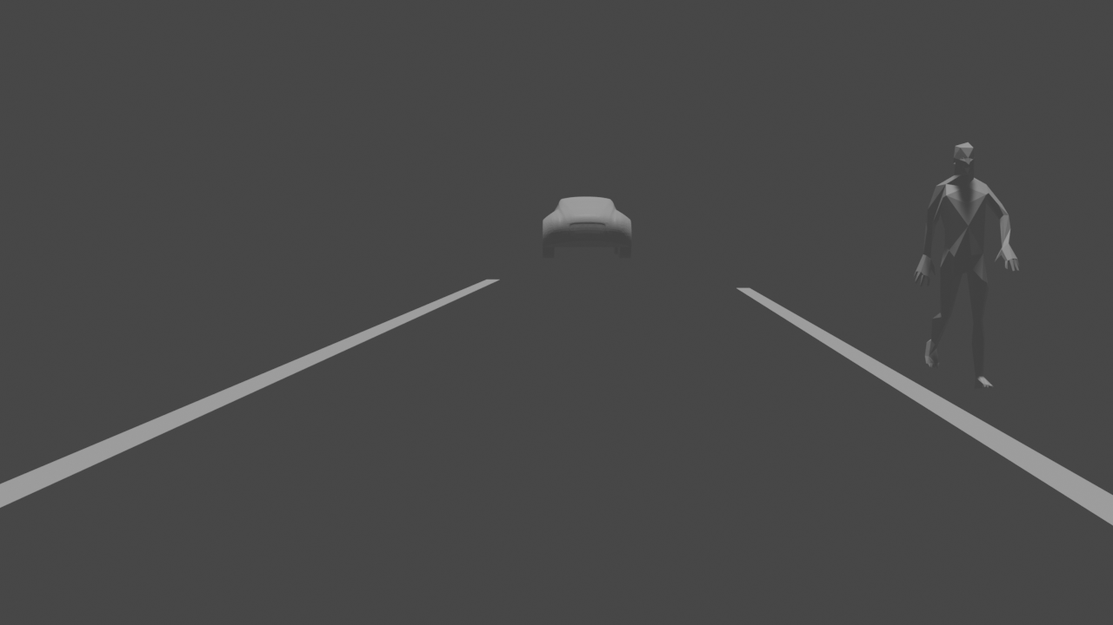
Questions?

